Slide 1
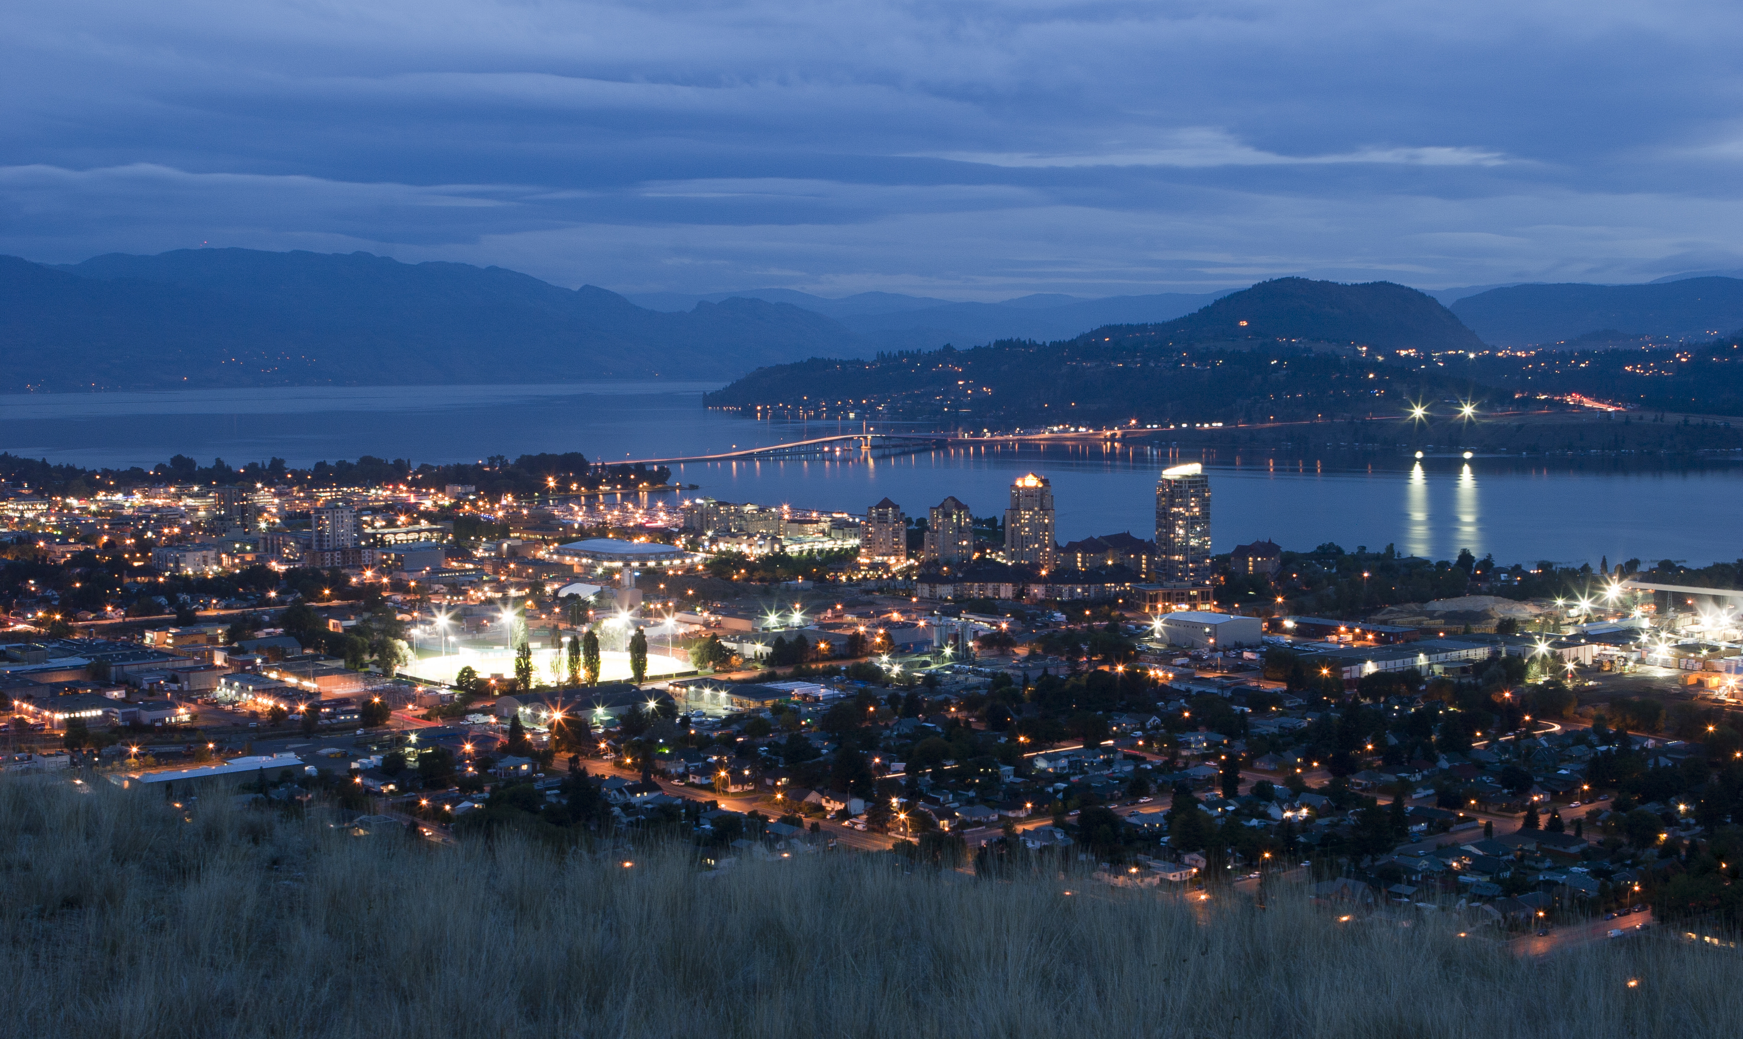
Kelowna RCMP and Police services
Resource Review
Curt T. Griffiths, Ph.D.
Nahanni Pollard, Ph.D.
Joshua J. Murphy, M.A.
Brent Jette, RCMP (ret.)

Slide 2
Objectives of an Operational Review
Identify
  Mandates (purpose, goals and objectives)
  Resources
  Structure
  Work (tasks and flow)
  Internal processes (i.e. work allocation, performance management and reporting)
  Partnerships/potential partnerships

Slide 3
Review Focus
Service Demands
Current alignments of Units
Workflow between supporting Units
Analytic support
Staffing, shifting re-alignment
Organizational placement consideration
Budget impacts

Slide 4
Data & Information Sources
Interviews
Focus Groups
  RCMP
  Municipal Employees
  Senior Management
  City stakeholders
  Community groups
Ride Alongs
Quantitative Data Analysis (CAD, RMS, Overtime)

Slide 5
Community Stakeholders
Kelowna Chamber of Commerce
Journey Home Society
Downtown Kelowna Association
Tourism Kelowna
BC Housing
Interior Health

Slide 6
Analysis of cad and rms data 2014-2018
Calls for Service (number, type, priority, etc.)
Allocated vs. Unallocated time per officer
Overtime usage
Response times and time at scene
Officer-Initiated calls vs. citizen-generated calls for services
Patrol staffing levels
Municipal crime patterns and “hot spots”

Slide 7
The Prosser Report (2012)
Resulted in addition of a number of officers
Impact difficult to determine, given lack of benchmarks and report-backs
Report is 7 years old; many of the issues that existed then have grown exponentially
Less holistic framework than the current project

Slide 8
The Context Of Canadian Policing
Role of court decisions, legislation, standards
Increasing assumed responsibilities (downloading)
Diversification of the police role
Increasing complexity of cases
Increased public expectations/issues of legitimacy/trust
Police/agency/community stakeholder partnerships

Slide 9
The Context Of Canadian Policing (con’t)
The increasing costs of policing
Concerns with “de-policing”
Emergence of tiered policing
Increased scrutiny of police operations/resourcing
Requirement to be best practice/evidence-based/intelligence-led
  performance metrics (ROI)
Policing as one component of a community safety and well-being plan

Slide 10
The Mental Health Of Officers And Civilian Employees
Increasing focus on mental health issues among members
On average, RCMP members score higher on key scales such as the Maslach Burnout Inventory, the Depression/Anxiety/Social Stigma Scale and PTSD scale
  Due in part to chronic understaffing of detachments
Extent of mental health issues among civilian staff unknown
Under-resourcing a major source of stress for officers, civilians, and municipal employees

Slide 11
The Kelowna Policing Environment
Fastest-growing city in BC
5th fastest-growing metropolitan area in Canada (1.8% vs. Canadian average of 1.4%)
The downtown core
The tourist season
Lack of provincial resources/coordinated plan

Slide 12
Kelowna Policing Environment (con’t)
In 2018, Kelowna had one of the highest Crime Severity Index (CSI) scores among Census Metropolitan Areas (CSAs) in Canada and recorded a 6% increase in its CSI score from 2017 to 2018
The property crime rate in Kelowna is exceptionally high, driven in large measure by drugs/addiction/ homelessness
Downtown Core/At Risk-High Needs Population
  Resource and officer-intensive
  Chronic offenders, many of who are homeless/addicted/and/or mentally ill

Slide 13
Kelowna Policing Environment (con’t)
Issues documented in the McKinnon Report
Public Safety & Crime Survey (April, 2019)
  Nearly all residents feel very safe or somewhat safe in their neighbourhood during the daytime
  Residents in Central Kelowna (69%) are significantly less likely than those in other regions to feel very or somewhat safe in their neighbourhood during the night
  Nearly one-quarter (24%) believe property crime rates have increased
  Citywide, residents think the most important crime-related problems are breaking and entering/property crimes and drug use (45% and 38% respectively of total residents)

Slide 14
Demands And Responses
High demand environment – # and seriousness of calls for service increasing
  High percentage of calls dispatched; limited triaging
Lack of detachment capacity to respond
Deployment of patrol officers does not match the demands for service
Detachment requires additional problem-solving capacity

Slide 15
Demands And Responses (con’t)
PACT patrol unit effective as initial response; need additional multi-agency team for long-term problem-solving for high-risk/high-need individuals
5 minute response time for Priority 1 calls
12% of Priority 1 calls for service attended by a single officer; an increase from 2015
  Indicates insufficient officers for back-up
  Safety/liability issues/Mental health issues

Slide 16
Demands And Responses (con’t)
Current patrol staffing is not in line with 1) call load; 2) file load average; or 3) comparison regions
Members carry an average caseload of 66 files per authorized member (patrol and investigations); comparable municipal officers carry an average of 32 files per authorized officer

Slide 17
Crime Prevention In Kelowna
Lack of a comprehensive crime prevention strategy
  Goals and metrics for crime prevention
  Adoption of best practice crime prevention interventions
  How crime prevention efforts interface with other activities of the detachment and with other stakeholders
Ideally, crime prevention should be a component of the community safety and well-being plan and the community policing strategy

Slide 18
Crime Prevention In Kelowna (con’t)
Unlike most detachments of its size, Kelowna detachment does not have an integrated crime prevention unit staffed by sworn officers and civilians
At present, crime prevention has little analytical support
Crime prevention personnel indicate that their activities are primarily reactive rather than proactive
As currently structured, the CPOs have a limited ability to carry out their mandate

Slide 19
Airport Security
“Aviation security- security of aircraft, airports and all elements of the aviation sector-is a key component of Canadian national security” (Federal Minister of Transport, 2006)
Exponential increase in passenger/aircraft traffic
10th busiest airport in Canada
Under-policed: currently one officer, 8-hour shift, M-F
  A security issue

Slide 20
The School Resource Officer (SRO) Program
SRO programs, if properly implemented, can be highly successful and provide a good ROI (c.f. Peel Regional Police)
5th largest school district in BC
Currently 3 SROs, each with as many as 18 schools
Delta (BC) PD SRO program good comparable/ best practice model; SRO officers’ tenure 3-5 years
  Delta: 1 SRO per high school; 1 SRO for elementary; patrol officer “adopt a school” program

Slide 21
Perceptions Of Community Stakeholders –
Chamber Of Commerce
Concerns over safety/security in downtown/growing street disorder
Lack of transparency from service providers (BC Housing, BC Health, RCMP) about solutions to concerns
Concern with lack of treatment beds
City downloading core municipal services onto business improvement associations

Slide 22
Perceptions Of Community Stakeholders – Journey Home Society
RCMP doing important work with challenging and at-risk population
DTEU has been “fantastic”
Need investment in mental health/addiction services
High risk/high need population needs more than supportive housing

Slide 23
Triaging Calls For Service
Little triaging of calls for service
Officers are responding to a large number of Priority 3 and Priority 4 calls
  Reduces their proactive time and ability to investigate more serious crimes
Potential for tiered policing/Telephone Response Team/Community Safety Officers

Slide 24
General Duty Members
Under-staffing of patrol is having a significant impact on the ability of the detachment to respond effectively to demands for service
  Ongoing difficulties meeting shift minimums
  Officers turning down overtime
  Places the officers at risk of mental health issues
GD officers are carrying up to 45 files, some of which are ICE files and Frauds over $100k
  Far more than their comparative counterparts
Officers have very little proactive time and are in danger of becoming call-takers

Slide 25
The investigators
There has been an increase in complexity and resource demands of the files
  Compounded by an inability to backfill positions when a member is away on maternity leave or for other purposes
The caseload is increasing and the specialized units in the detachment are unable to take every file
  This results in files being passed down to GD patrol officers.
Important areas not given attention, e.g. child pornography
Limited ability to work cold cases
Investigations impacted by the Jordan decision; disclosure

Slide 26
The By-law Officers
Provide an order maintenance presence in the downtown core
Can be a valuable component of tiered policing
Important to set strict parameters on activities/authorities
  Issues of public safety and municipal liability
  Guard against “mission creep”
Training/supervision/interface issues

Slide 27
Analytics
The workload of the analytics unit is not sustainable
Insufficient capacity to support patrol, investigations, crime prevention, business analysis
Limited capacity for intelligence-led policing and problem-solving analytics, e.g. problem premises; chronic offenders; predictive policing

Slide 28
Civilian Municipal Employees
Lack of capacity in critical areas, e.g. disclosure, transcription, exhibits
Staff are overloaded with work
  Often come into the detachment on evenings, holidays, and weekends.
  High stress levels and at risk of mental health issues
Need “floaters” (rovers) rather than casuals
Need to conduct a job evaluation survey

Slide 29
Tiered Policing: The Promise And The Peril
Tiered policing is a key feature of best practice policing
Must be carefully designed to avoid “mission creep” and liabilities
Must be a component of an overall community policing/engagement strategy
Can involve private security, DT Ambassadors, By-Law officers, community safety personnel, and sworn members

Slide 30
Preliminary Workload Statistics

Slide 31
How Demands Are Received

Slide 32
Percentage Of Calls Dispatched
(varies by method of receipt)

Slide 33
9-1-1 call volume on the rise

Slide 34
Top 10 priority 1 calls
(% change)

Slide 35
Top 10 priority 3 calls
(% change)

Slide 36
Abandoned 9-1-1 service impact

Slide 37
Timing Of Service Demands

Slide 38
Seasonal trends, % difference from yearly average (2018)

Slide 39
Seasonal and temporal trends, 2018 dispatched calls, p1-p4 only
May-August tourist “surge”
Call impact significant during the day and weekend increases during the “surge”

Slide 40
Modified Shifting = More Even Workload
Example of file load per hour (2018 average) vs. flat shifting model (with early car) and example of 3 shifting model with fewer overall officers
3-shift model has 72 officers overall, with 12 assigned per shift (example)
7:00 a.m. – 7:00 p.m. (ramp up); 9:00 a.m. – 9:00 p.m. (ramp up); 7:00 p.m. – 7:00 a.m. (ramp down)

Slide 41
Shift correlation with call load
Flat shift has no statistical relationship to the call load
3-shift example has a very statistically strong relationship to the call load (as calls go up, staffing increases). This model is statistically significant (not possible by chance)
Provides better coverage

Slide 42
Recommendations
The detachment should develop the capacity to assess on an ongoing basis the effectiveness and efficiency of its operations
Report-backs should be provided to municipal council on the impact of any additional resources
The detachment should develop a community policing strategy that would include prevention, enforcement, and partnerships
The detachment can be a major contributor/component of a community safety and well-being plan via the community policing strategy

Slide 43
Recommended Sworn Positions
Foot patrol | 6 | Properly deployed, foot patrols can provide increased police visibility and reassurance policing; it is suggested that foot patrol be deployed in different areas of the city and not just in the downtown core. This resource can be extended by deploying foot patrol officers with by-law officers. It is envisioned this would be a single daily shift, from 0800 to 2000, or 0900 to 2100.
School Resource Officer (SRO) | 5 | SRO programs have been shown by research to have a significant impact on the quality of life in the school community, to improve student and teacher morale, to have a positive impact on student behaviour, and to be of assistance in law enforcement. The current SRO program in Kelowna is too understaffed to have an appreciable impact. The Delta Police Department was used as a comparable to determine the number of additional positions required.
General Duty Patrol | 16 | The current GD staffing levels are not adequate to meet the demands for service. There are ongoing challenges in meeting shift minimums and in having officers work overtime to fill shift complements. GD officers are carrying as many as 45 files. This is up to twice as many as RCMP officers in comparable detachments.
Investigations (Major) | 10 | Current lack of capacity.

Slide 44
Recommended Sworn Positions
Crime Prevention | 4 | Kelowna detachment is unique in that it does not have a crime prevention unit staffed by sworn members who work with civilian members.
Neighbourhood Police Officer | 4 | It is important to have officers engaged in proactive community engagement in areas other than the downtown core.
AOT and ACT teams | 4 | The PACT units are primarily reactive and are not involved in long-term problem solving. The AOT and ACT teams have demonstrated success in addressing the needs of at-risk and vulnerable individuals who have a lengthy history of contact with the police and other agencies. The VPD AOT and ACT teams can serve as a model. The ACT teams involves police officers working with other professionals, while the AOT team is a partnership with Vancouver Coastal Health. These positions would be allocated in lieu of another PACT patrol unit.
General Investigation (Patrol-aligned) | 4 | General Duty members are currently carrying files that involve complex investigations. Given the service demands on GD officers, this often results in officers not having time to conduct adequate investigations. GD officers in comparable detachments and municipal police services are not responsible for investigating complex files. These additional officer would be permanently attached to the GD watches to assist with these cases.

Slide 45
Recommended Civilian ME Positions
Police Information Clerk | 1 | This will allow extended front counter hours during the week and 5 hours on Saturday and Sunday. The current hours of the front counter are limited in comparison to other similar-sized detachments. Police accessibility to the public increases trust and confidence in the police.
Exhibits | 2 | Current lack of capacity
Disclosure | 1 | Current lack of capacity
Transcription | 2 | The transcription section is backlogged and the 90-120 delays in completing transcripts is too lengthy and may compromise the timeliness of prosecutions under the Jordan decision.
Volunteer Coordinator | 1 | Current lack of capacity
Crime Review Section | 1 | Current lack of capacity
Crime Analysts | 3 | Current lack of capacity; these positions should be assigned to crime prevention, patrol, and business analysis.

Slide 46
Current Detachment Resources
The sworn members and municipal employees are dedicated and professional
The Kelowna RCMP detachment is currently under-resourced in a number of sworn and civilian support areas
This impacts the ability of the detachment to respond to service demands from the community, to development strategic partnerships with the community, and to implement and sustain effective crime prevention, crime attack, and crime response strategies
Impacts the officers, municipal employees, and the community

Slide 47
Questions

